Slide 1


Tableplop: Hacking a Free VTT for OSR via Curve Fitting
Brucifer
Disclaimer: This is not so much a talk about
a Cybersecurity Hack, more a talk about a
Hack for fun (and profit?)

Slide 2
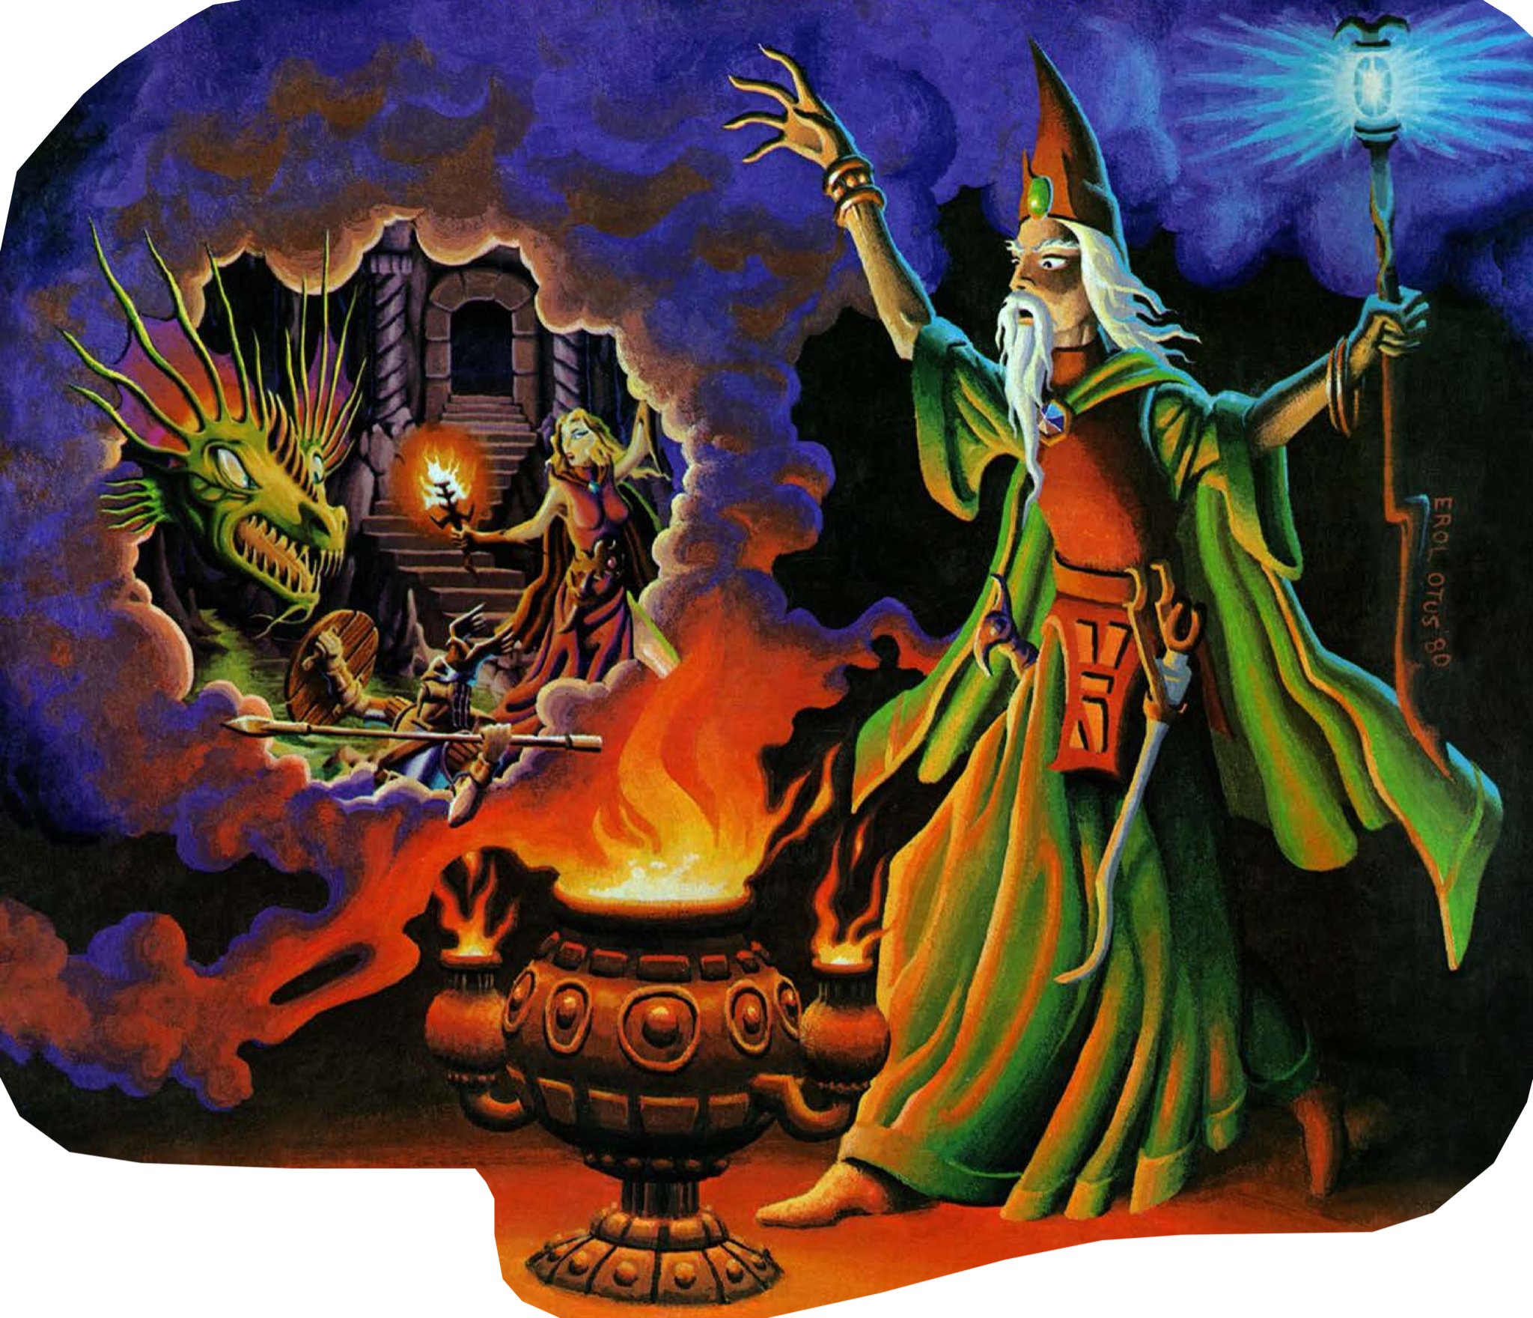

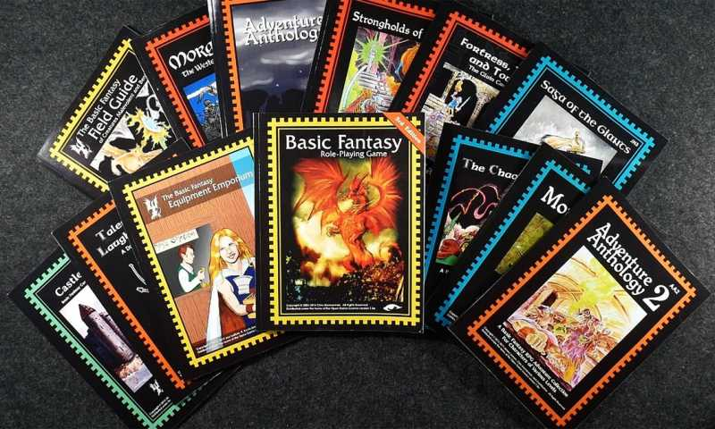
Why OSR, Why VTT, Why Free?
Playing/DM’ing since late 1970’s
No Edition Wars here - simply what I know best
Move from in-person to remote play
Tried Play-by-Post, interesting, not satisfying
I’m cheap
Started with BECMI/Rules Cyclopedia, moved to Basic Fantasy RPG - an OSR based on original B/X rules, but… updated with some more modern concepts - Ascending AC, Separation of Race/Class, etc.
It’s Free: https://basicfantasy.org/

Slide 3


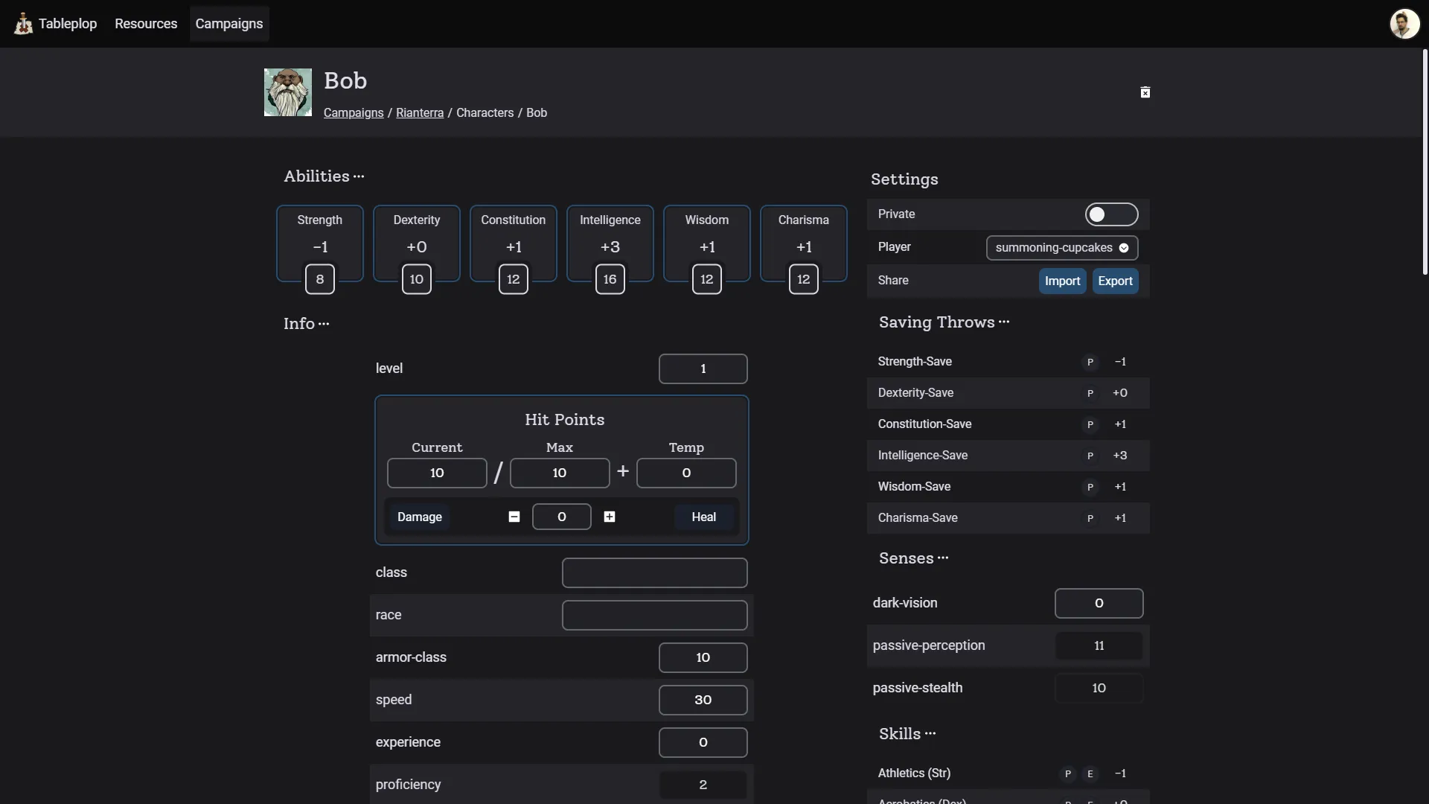

What is Tableplop?
Community supported VTT
Modern and Lightweight
Free/Patreon https://tableplop.com/
Default 5e character templates
Build your own character templates
Uses expr-eval for formulas/calculations

Slide 4
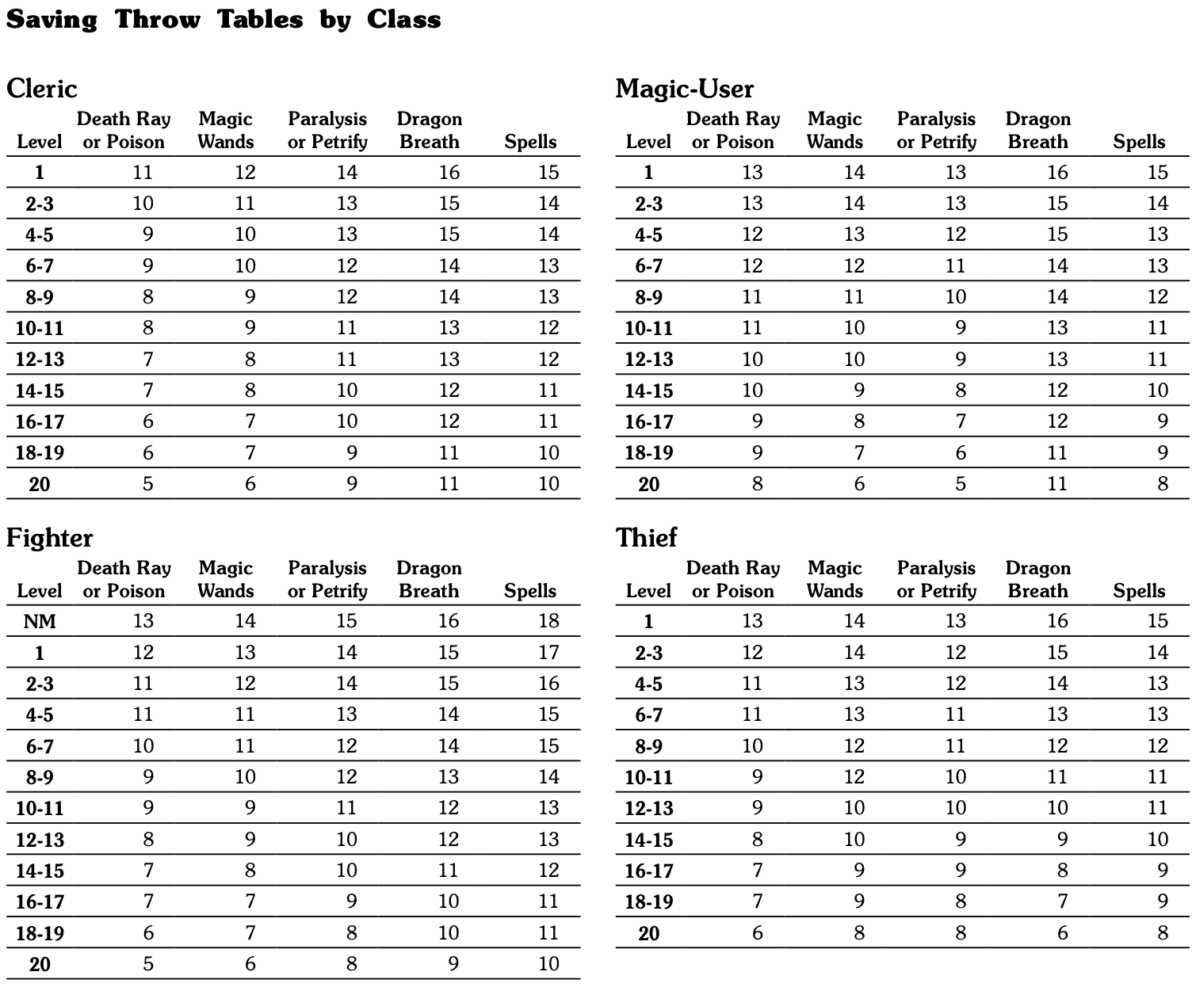
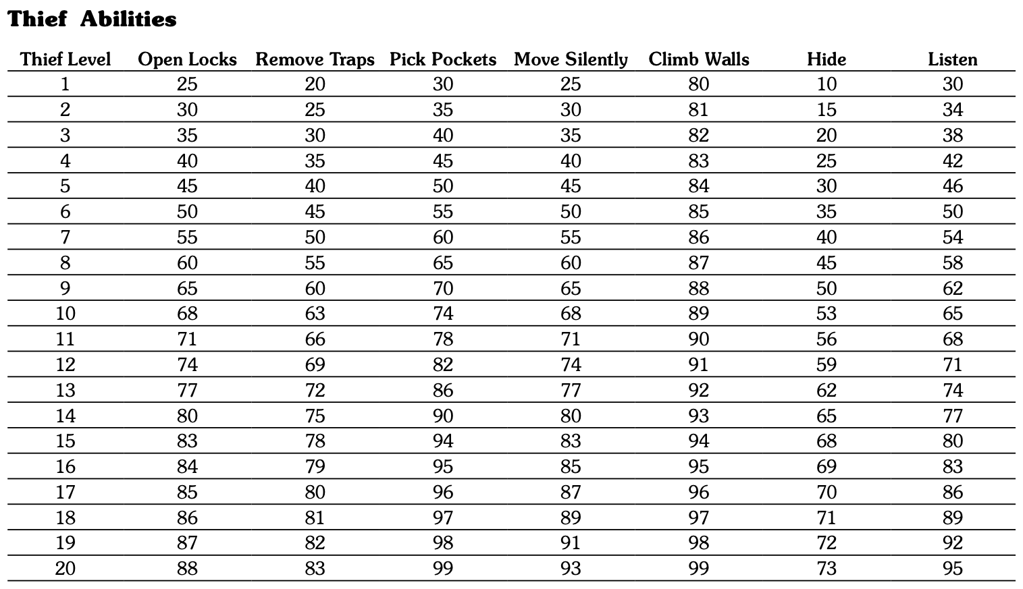
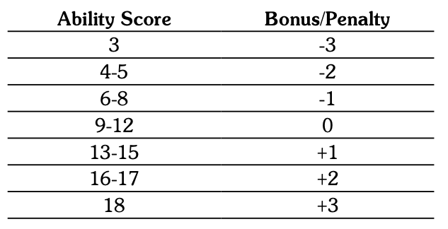
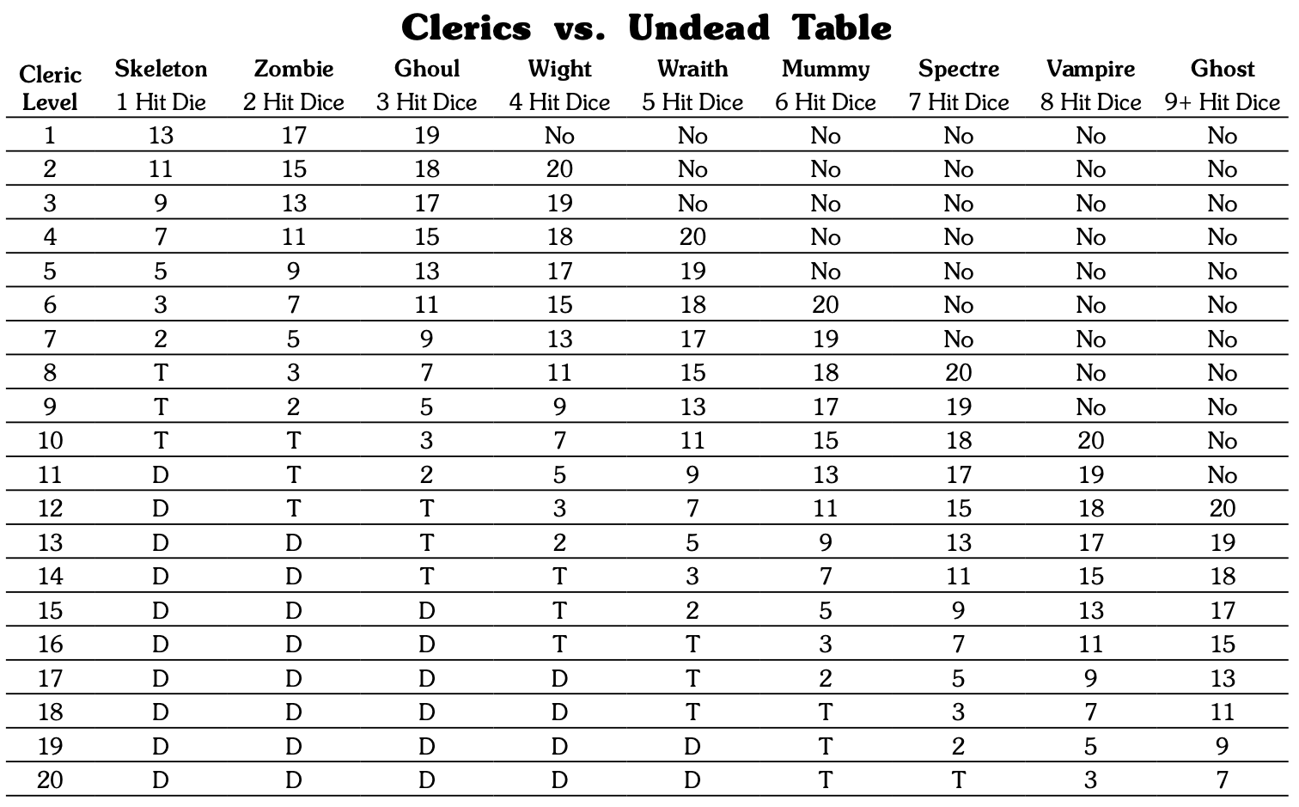
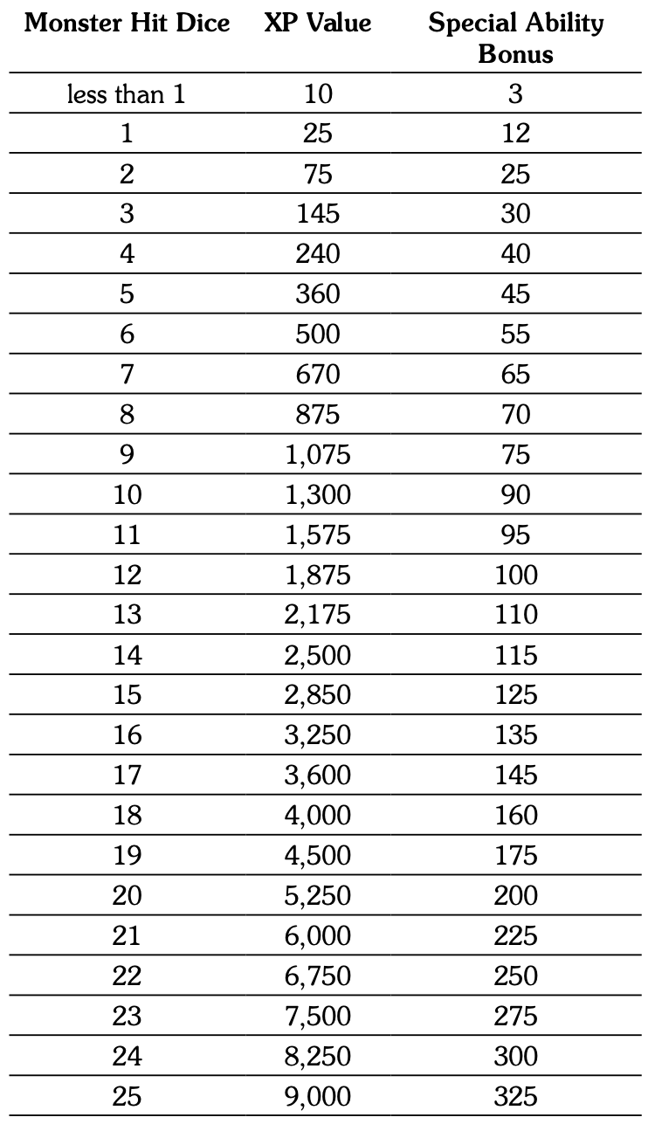
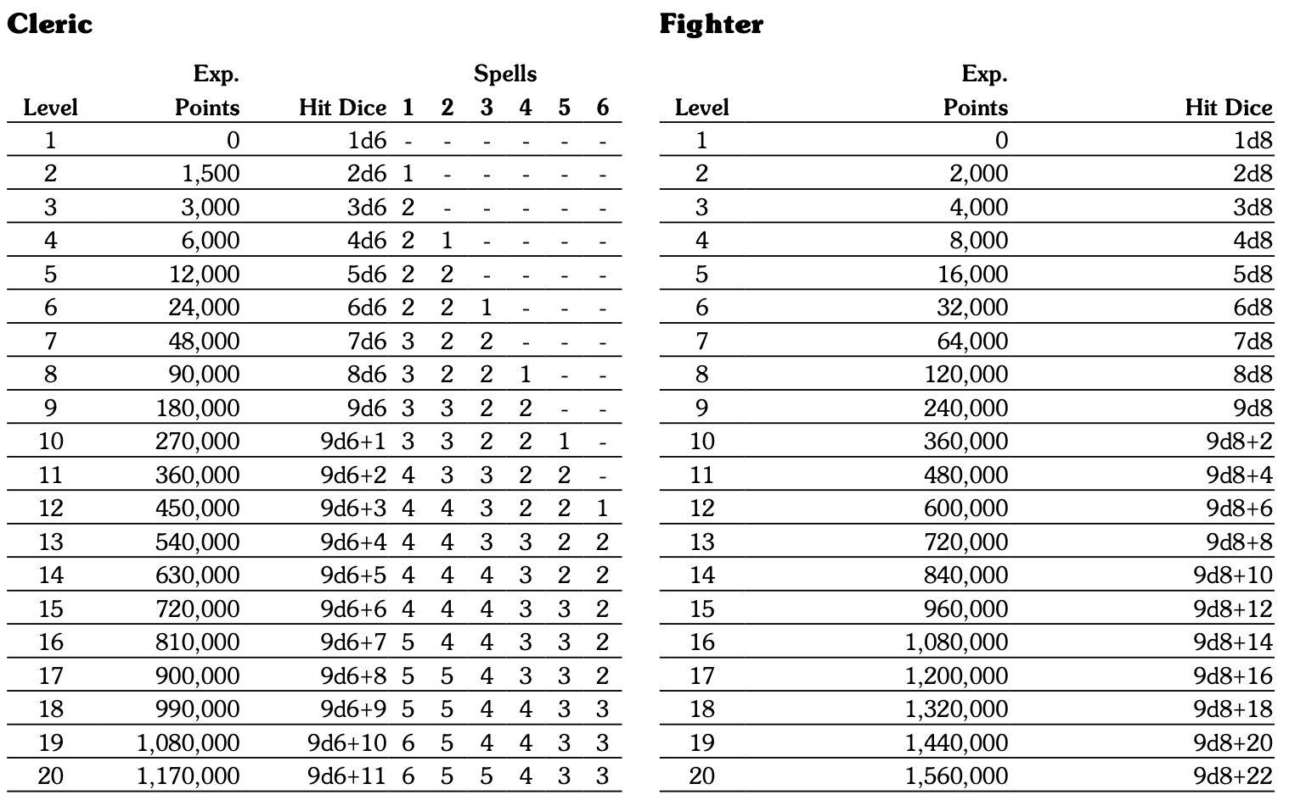
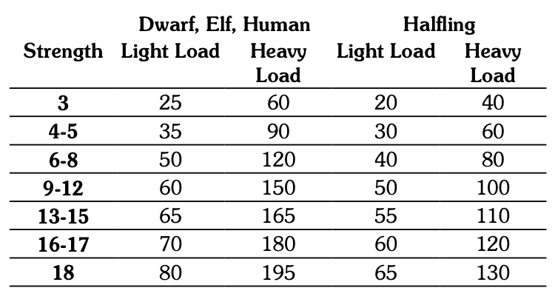
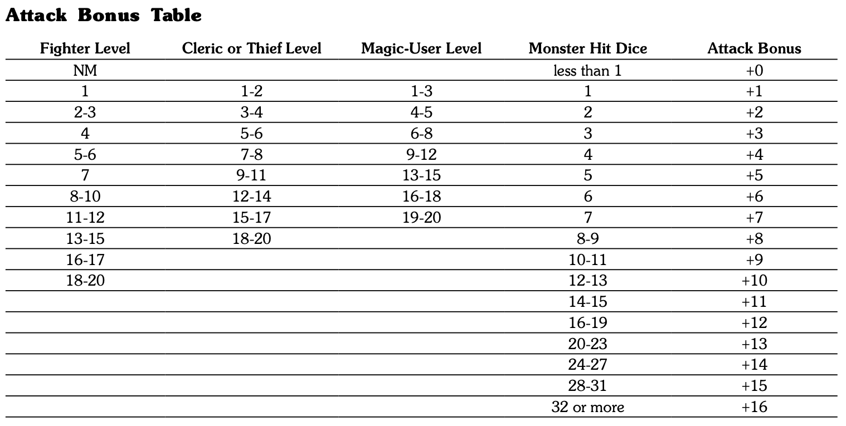
Challenge: OSR Tables
Modern games use simple formulas
OSR games tend to use tables for:
Ability Bonus/Penalty
Experience Point Progression (by class)
Spell Allotments (by class)
Hit Dice (by class)
Special Abilities (Thief, Bard, Assassin, Ranger, etc.)
Carrying Capacity (for Equipment, by Race)
Monster Experience Points (by Hit Dice and Special Abilities)
Attack Bonus (by class and level/Hit Dice)
Cleric vs. Undead; Turning (by class and Hit Dice)
Saving Throws (by class with race bonuses)
And on, and on, and on…

Slide 5
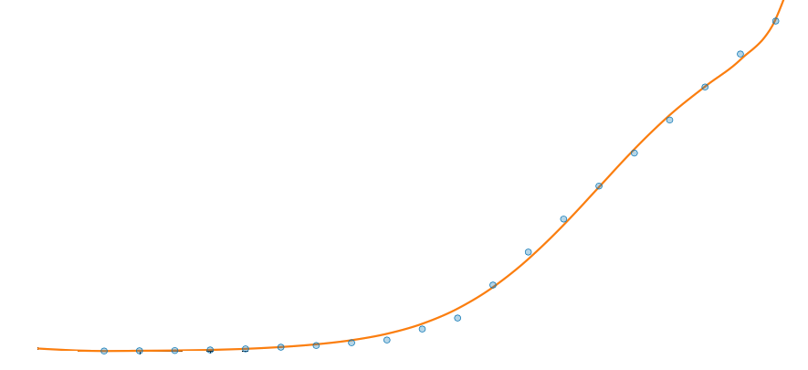
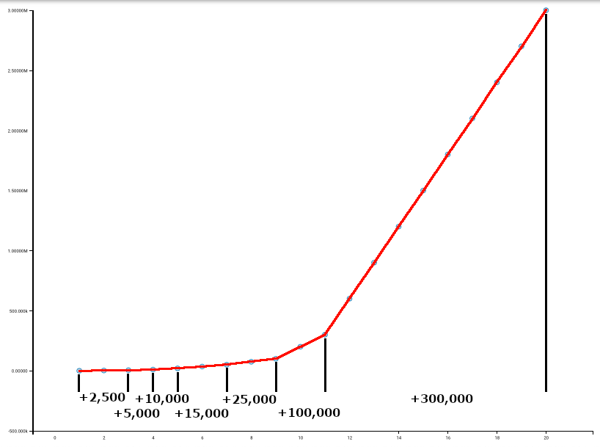
Challenge: OSR Tables (cont.)
In Tableplop and most VTTs, there is no mechanism for storing/accessing tables, simple formulas only are supported
In many OSR games, there is no rhyme or reason why the tables were built or populated as they are (“because Gygax wrote it that way”)
Ex: D&D Original Edition (1974) Magic-User XP per Level:
Solution: Represent the table values with a mathematical function. This requires being able to represent the table values to the function curve on A graph. Discovering that function is known as “Curve Fitting”
Works for any game with tables/rules that are copyrighted, because this is just math and copyright protection does not apply.

Slide 6
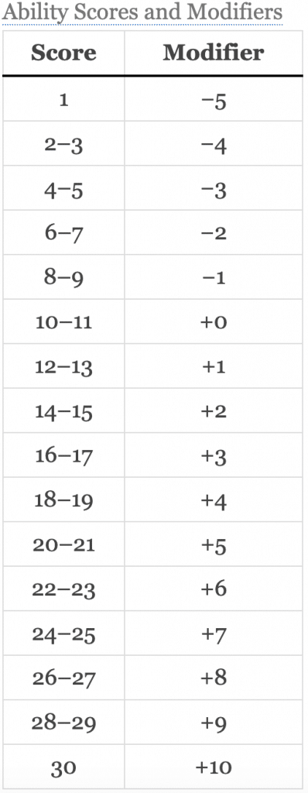
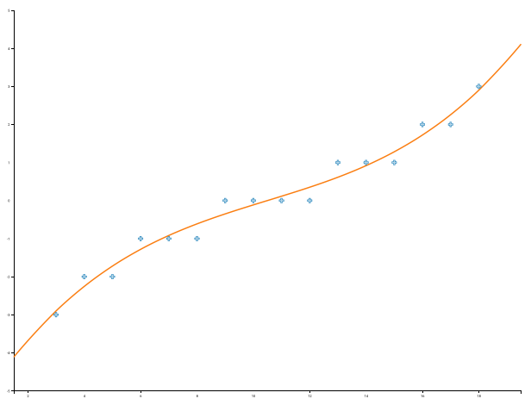
A Simple Example: Ability Bonus/Penalty
The Classics: Strength, Intelligence, Wisdom, Constitution, Dexterity, Charisma
5e Formula: =floor((ability-score-10)/2)
A Curve Fitting Calculator: https://planetcalc.com/8735/
5-th order polynomial
7 digit precision
Use ROUND() function to output a whole integer
Result: =round((-7.483032) + (2.396571*ability-score) - (0.3875923*(ability-score^2)) + (0.03564341*(ability-score^3)) - (0.001667064*(ability-score^4)) + (0.00003175359*(ability-score^5)))

Slide 7
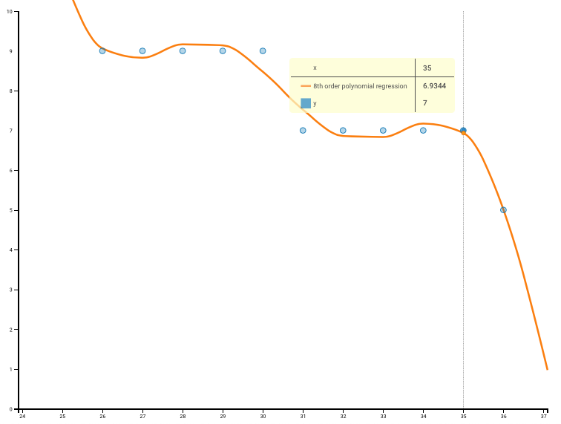
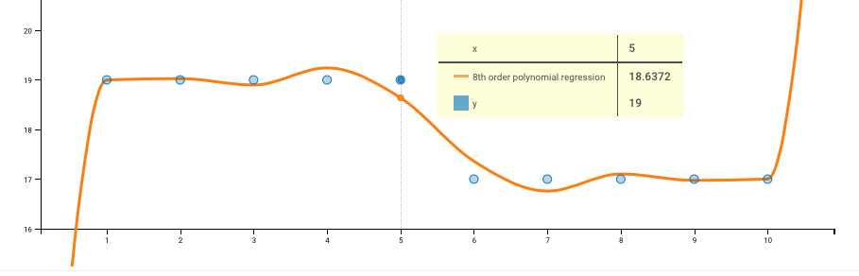
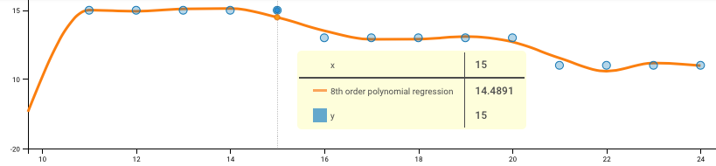
More Complex Example: THAC0 Attack Table
3 functions for smaller ranges (1-10, 11-24, 24+ Hit Dice)
8th-order polynomials
12 digit precision
Curve Fitting (BECMI Magic-User THAC0): =if(lv<11,round(0.0000979010024957*(lv^8)-0.0037701484098117*(lv^7)+0.0585601565116233*(lv^6)-0.470831183288496*(lv^5)+2.09994463764019*(lv^4)-5.21393817229583*(lv^3)+6.8936121164948*(lv^2)-4.35177853567679*lv+19.998376236763),if(lv>24,round(-0.0000002816508653*(lv^8)+0.00012511414154*(lv^7)-0.0193577908855009*(lv^6)+1.54068450049682*(lv^5)-72.0234056905753*(lv^4)+2066.24868704549*(lv^3)-35920.5086979828*(lv^2)+348299.783251627*lv-1448542.05949315),round(-0.0000019574045683*(lv^8)+0.0002302221698072*(lv^7)-0.0110955503602492*(lv^6)+0.275551515097848*(lv^5)-3.48834091630104*(lv^4)+13.7088413619814*(lv^3)+171.11095383838*(lv^2)-2171.25709582529*lv+7232.63043272231)))

Slide 8
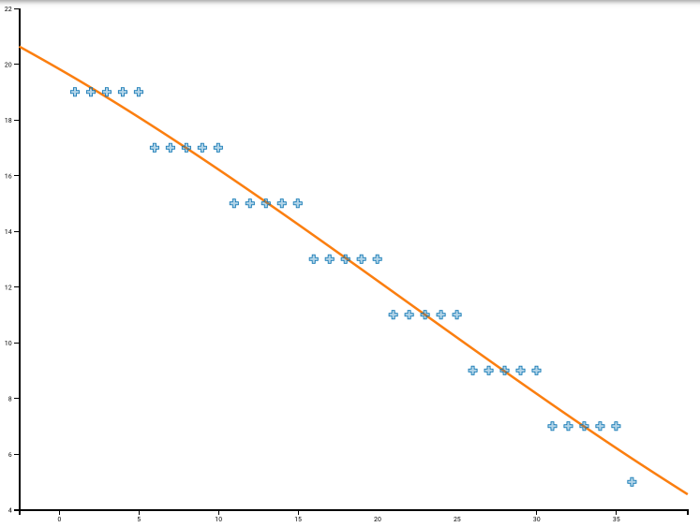
Think Outside the Box: THAC0 Attack Table
Noticed a trend, y values were the same in each set of 5 numbers
Easily solved using the CEILING function: =-2*ceiling(hd/5)+2

Slide 9


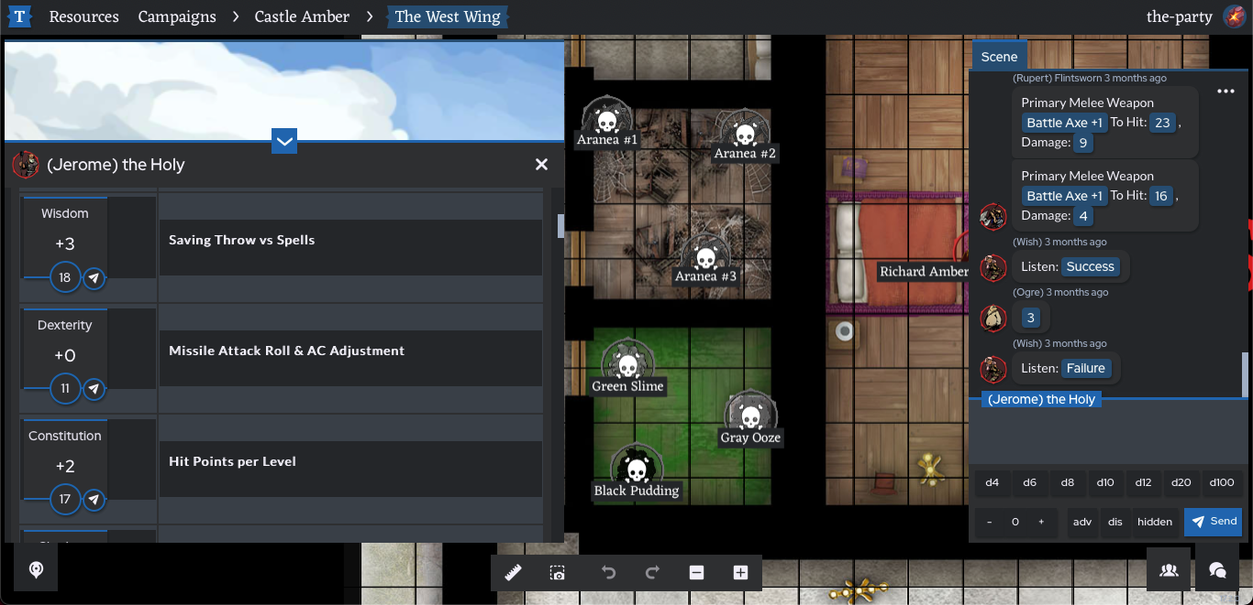
Character & Monster Templates
https://github.com/brooocifer/tableplop-content

Slide 10

Thank You!
https://basicfantasy.org/
https://tableplop.com/
https://planetcalc.com/8735/
https://github.com/brooocifer/tableplop-content
Brucifer

